Slide 1

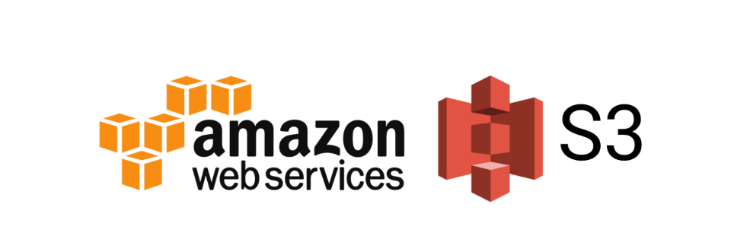

Slide 2


Topics
What is s3
Data Consistency
S3 Storage Tiers
Cross Region Replication
S3 Transfer Acceleration
Point to remember

Slide 3
What is S3?
Stand of - Simple Storage Service
Amazon Simple Storage Service (Amazon S3) is an Object storage service that offers industry-leading scalability, data availability, security, and performance.
S3 provides developers and I.T. teams with secure durable highly scalable objects storage.
It's easy to use with a simple webservices interface and it allows you to store and retrieve any amount of data from anywhere on the web.
Safe place to store your file
It is Object-based Storage
Data is spread across multiple devices and facilities

Slide 4

S3 Basics
Object-based
File's size:- 0 bytes to 5 TB
Unlimited storage
Files are stored in Buckets ( similar to drive)
S3 name should be universal namespace - across AWS
https://my-bucket.s3.amazonaws.com/puppy.png
s3://mybucket/puppy.jpg
When you upload a file to s3, http 200 code for successful upload- through command line

Slide 5
S3 Basics Continue…
Built for 99.99% availability for s3 platform ( service is accessible 99.99% time)
Amazon Guarantee 99.9% availability
Amazon Guarantees 99.999999999% durability for S3 information ( 11 x 9s)
for example:- You want to store 10 million objects within S3, with 11 X 9s ability, on average you could expect to incur a loss of a single object once every ten thousand years.
Storage type available
Lifecycle Management
Versioning
Encryption
MFA Delete
Secure data using access control list and bucket policy

Slide 6
Data Consistency
Read after write consistency for PUT of new objects. (as soon as upload, we can read/access)
Eventual Consistency for overwrite PUT and DELETE ( can take some time to propagate)
If you write a new file and read it immediately afterwards, you will be able to view that data
If you update AN EXISTING file or delete a file and read it immediately, you may get the older version, or you may not. Basically, changes to objects can take a little bit of time to propagate

Slide 7
S3 is key-value store
S3 is object based. Objects consist of following:
Key (This is simply the name of object)
Value (This is simply the data, which is made up of a sequence of bytes)
Version ID ( version control)
Metadata ( Data about data you are storing)
Sub resources - bucket specific config
bucket policies, access control list
cross origin resource sharing
transfer acceleration

Slide 8
S3 Storage Tiers/Classes
S3-Standard:
99.99% availability, 99.999999999% durability, stored redundantly across multiple devices in multiple facilities and is designed to sustain the loss of 2 facilities concurrently.
S3-IA (Infrequently Accessed):
For data that is accessed less frequently but requires rapid access when needed. Lower fee than Standard, but you are charged retrieval fee.
S3-One Zone IA:
Same as IA, however data is stored in single availability Zone only, till 99.999999999% durability, but only 99.5% availability. Cost is 20% less than S3-IA

Slide 9
S3 Storage Tiers/Classes continue…
S3-Intelligent Tiering-launch in 2018:
Unknown or Unpredictable access patterns
2 tiers - frequent and infrequent access
Automatically moves your data to most cost-effective tier bases on how frequently you access each object
So how does it work.:-if an object is not accessed for 30 consecutive days, then it gets moved automatically to the infrequent access here, But then as soon as an object which is in the infrequent access to is accessed it gets automatically moved to the frequently accessed here and S-3 intelligent tiering has the same level of jury ability and availability as you would expect for the normal S-3 infrequently accessed
Reduced Redundancy Storage:
Designed to provide 99.99% durability and 99.99% availability of object over a given year. Used for data that can be recreated if lost, eg- thumbnails. ( might not be in console but still in exam)

Slide 10
S3 Storage Tiers/Classes continue…
S3 Glacier:
Very cheap but used to archival only. Optimized for data that is infrequently accessed, and it takes minutes to hours to restore from Glacier. Example :- Due to Federation rules, companies might have to store data for 5-7years
S3 Glacier Deep Archive:
AWS S3’s lowest cost storage class where retrieval time of 12 hours acceptable.
There are no fees for accessing your data or for moving the data in between tiers

Slide 11
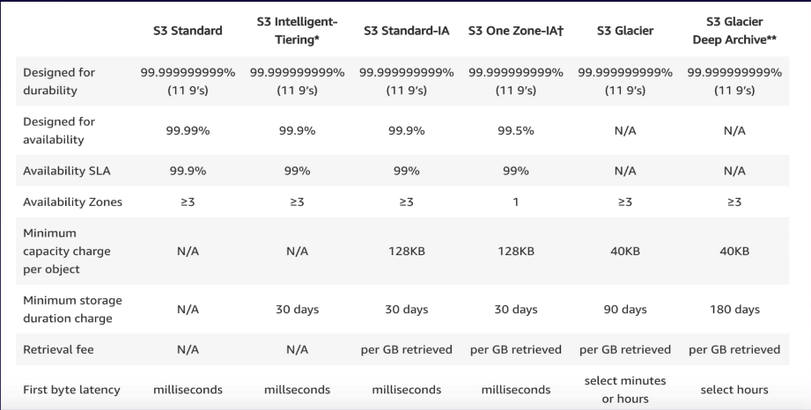
S3 Storage Tiers/Classes Comparison

Slide 12
S3 Charges:
Storage per GB
Request(Get, Put, Copy, etc)
Storage Management Pricing (Inventory, Analytics, and object Tags)
Data Management Pricing. Data transferred out of s3 , free to transfer into s3
Transfer acceleration
Cross region replication

Slide 13



Cross Region Replication

Slide 14
S3 Transfer Acceleration:
S3 transfer acceleration enables fast, easy and secure transfers of files over long distances between your end users and S3 bucket.
It takes advantage of Amazon's cloud fronts globally distributed edge locations.
As the data arrives at an edge location, it is routed to Amazon S3 over and optimized network path

Slide 15
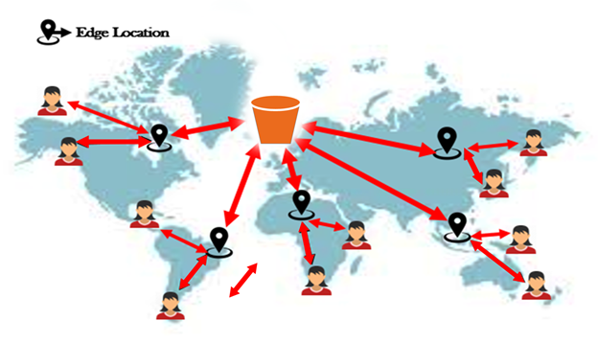
S3 Transfer Acceleration:
1 – End user to edge node
2 – Amazon Back bone N/W
2
1
1
2
2
2
2
1
1
1

Slide 16
Point to remember:
S3 is Object-based
Not suitable to install an operating system or running a database on it.
Files can be from 0 bytes to 5TB.
There is unlimited storage.
Files are stored in buckets
S3 is universal namespace.
https://my-bucket.s3.amazonaws.com/puppy.png
s3://mybucket/puppy.jpg
Read after write consistency for PUT of new objects. (as soon as upload, we can read/access)
Eventual Consistency for overwrite PUT and DELETE ( can take some time to propagate)

Slide 17
Point to remember Continue…
S3 storage classes:
S3-Standard: durable, immediately available, frequently accessed
S3-IA: durable, immediately available, infrequently accessed
S3-One Zone IA: Same as IA. however data is stored in single availability Zone only
S3-Intelligent Tiering:- Automatically moves your data to most cost-effective tier bases on how frequently you access each object
Glacier - Archived data, Optimized for data that is infrequently accessed, and it takes minutes to hours to restore
Deep Glacier - Archived data, AWS S3’s lowest cost storage class where retrieval time of 12 hours acceptable.

Slide 18
Point to remember Continue…
Core fundamentals of s3 object:
Key(name)
Value(data)
Version ID
Metadata
Sub-Resources
- bucket specific config
- bucket policies, access control list
- cross origin resource sharing
- transfer acceleration
Successful upload from CLI generate a HTTP 200 status code
You can turn on MFA Delete

Slide 19
Thank you

